Slide 1




EE-304
REAL TIME OBJECT DETECTION AND DISTANCE MEASUREMENT
Vishwanath Dorlikar 210002029
Ebrahim Rampurawala 210002030
Girish Jarwal 210002033

Slide 2
INTRODUCTION
This presentation focuses on how we can leverage computer vision algorithms and mathematical principles to perform object detection and accurately estimate distances in real-time scenarios.
Importance of Object Detection:
Object detection is a fundamental task in computer vision that involves identifying and locating objects of interest within an image or video stream. This capability has widespread applications across industries such as surveillance, autonomous vehicles, healthcare, and retail. By accurately detecting objects, we can enable a range of intelligent systems to make informed decisions and take appropriate actions.
Significance of Distance Estimation:
Distance estimation complements object detection by providing spatial information about detected objects. Conventionally for measuring depth, depth cameras are used which are very expensive. With the help of machine learning we can estimate the depth of objects through standard 2D pictures. Our project combines object detection with distance estimation to enhance the overall perception capabilities of computer vision systems.

Slide 3
METHODOLOGY
PREPROCESSING AND OBJECT DETECTION:
OpenCV Setup: We initiated by setting up OpenCV to access the camera and capture video frames.
Object Detection with Pre-trained Model:
Model Loading: We loaded the pre-trained object detection model which is SSD MobileNet v3 Large Coco 2020 into memory.
Inference on Video Frames: For each captured frame, we performed inference using the loaded model. This involves passing the frame through the model's convolutional layers.
Bounding Box and Confidence Score Extraction: The model's output provides bounding boxes encompassing the detected objects within the frame and corresponding confidence scores for each detection.
Bounding boxes: These define rectangular regions around the detected objects.
Confidence scores: These represent the model's certainty for each detection, ranging from 0 (low confidence) to 1 (high confidence).
Thresholding: We set a confidence threshold (e.g., 0.5) to filter out detections with low confidence, improving the accuracy of our results.

Slide 4
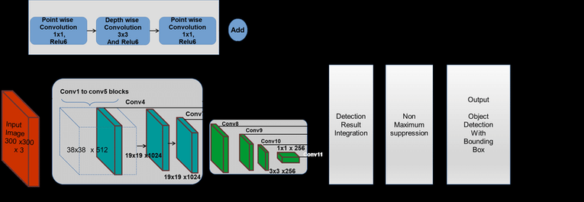
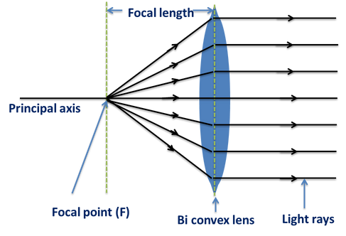
DISTANCE ESTIMATION CALIBRATION:
Calibration: We captured a reference image of an object with a known real-world size (e.g., a ruler) placed at a known distance from the camera.
We ran the object detection model on the reference image to obtain the bounding box for the known object (measured width in pixels).
Using the formula Focal Length = (measured_width * distance) / real_width, we calculated the camera's focal length based on the object's real size, measured size, and known distance.
Live Video Distance Estimation: For each object detected in the live video frame with a confidence score exceeding the threshold:
We measured the width of the object's bounding box in pixels.
We employed the pre-calculated focal length from calibration.
We utilized the formula Distance = (measured_width * focal_length) / real_width to estimate the object's distance from the camera in real-world units.

Slide 5
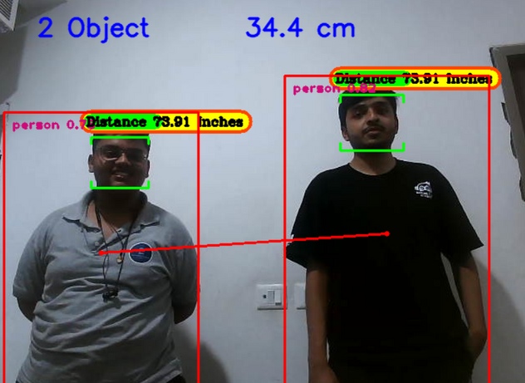
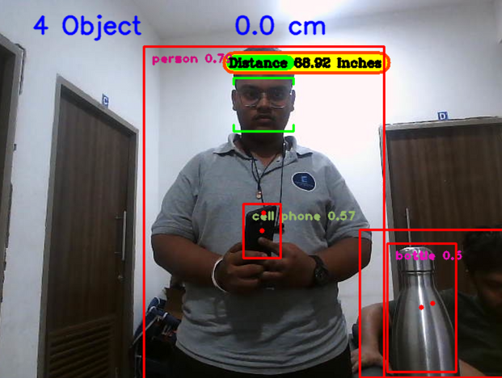
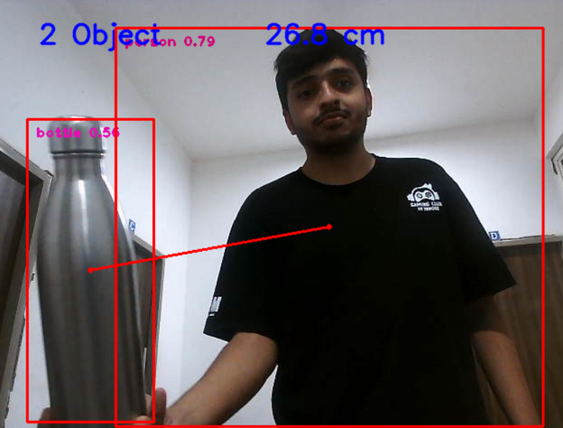
RESULTS
Using our model we can predict distance from the camera of the object and the distance between two objects.
Our model is able to predict the distance from the camera of the object with 84% accuracy and the distance between objects with 81% accuracy.

Slide 6
CONCLUSION
In this presentation, we have explored the comprehensive journey of designing and deploying an object detection and distance estimation system using SSD MobileNet v3 with the COCO 2020 dataset.
The choice of SSD MobileNet v3 was instrumental due to its efficiency and effectiveness in processing real-time video feeds while maintaining high accuracy and speed, crucial for practical applications such as autonomous driving and surveillance systems.
The integration of the COCO 2020 dataset proved vital in training our model with a diverse set of images, enhancing its robustness and reliability across various scenarios.
REFERENCES
A. A. Adz-Dzikri, A. Virgono and F. M. Dirgantara, "Advance Driving Assistance Systems: Object Detection and Distance Estimation Using Deep Learning,"
Liu, W. et al. (2016). SSD: Single Shot MultiBox Detector. In: Leibe, B., Matas, J., Sebe, N., Welling, M. (eds) Computer Vision – ECCV 2016. ECCV 2016.
Z. Chen, R. Khemmar, B. Decoux, A. Atahouet and J. -Y. Ertaud, "Real Time Object Detection, Tracking, and Distance and Motion Estimation based on Deep Learning: Application to Smart Mobility,"

